Slide 1
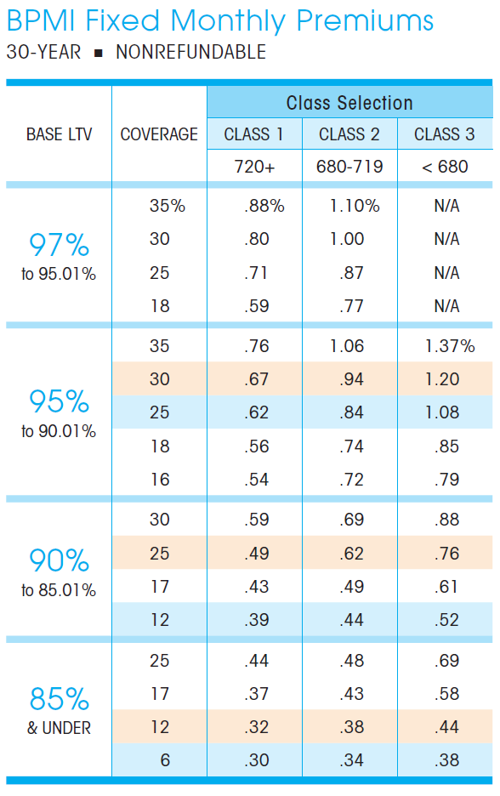

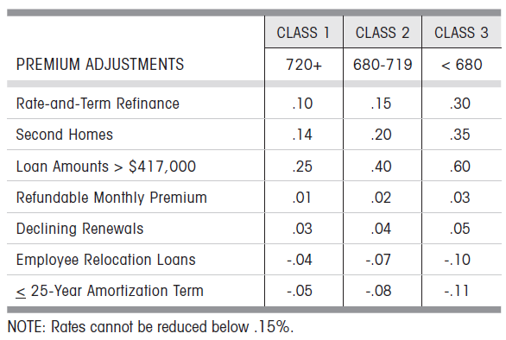
Current MI Calculation
Example Loan:
Loan Seq Num: U60490000208
Step 1: Find the right version of MGIC document based on loan origination date
firstPaymtDt | 4/1/2011
cs | 781
origLTV | 121
loanPurposeType | RE-FI-NCO
occType | OWNER
originalLoanAmount | 89320
pctMtgIns | 20
origPMI | 1.83

Slide 2
Current MI Calculation
Example Loan:
Loan Seq Num: U60490000208
Step 2: Find the MI premium based on loan info
firstPaymtDt | 4/1/2011
cs | 781
origLTV | 121
loanPurposeType | RE-FI-NCO
occType | OWNER
originalLoanAmount | 89,320
pctMtgIns | 20
As the LTV is greater than the largest number in the table, we assigned the max number (or a number of 1000 bps) in the table to the base MI (i.e., we ignore what the credit score is).
We will have a PMI of 110 bps for the loan.

Slide 3
Current MI Calculation
Example Loan:
Loan Seq Num: U60490000208
firstPaymtDt | 4/1/2011
cs | 781
origLTV | 121
loanPurposeType | RE-FI-NCO
occType | OWNER
originalLoanAmount | 89,320
pctMtgIns | 20
110 bps is misleading since HARPed loans pay no MI or carry over their MI from the previous loan.
We need to find out what MI the HARPed borrower was paying before they refinanced.
Problem:
We don’t have information for their previous loan.
As LTV greater than the largest number in the table, we assigned the max number (or a number of 1000 bps) to the base MI.
Possible solution:
One information we can use is the pctMtgIns which is the MI coverage level.
We could use the coverage level to look up MI rates from MGIC documents from before 2009/06.
We will have a PMI of 110 bps for the loan.

Slide 4
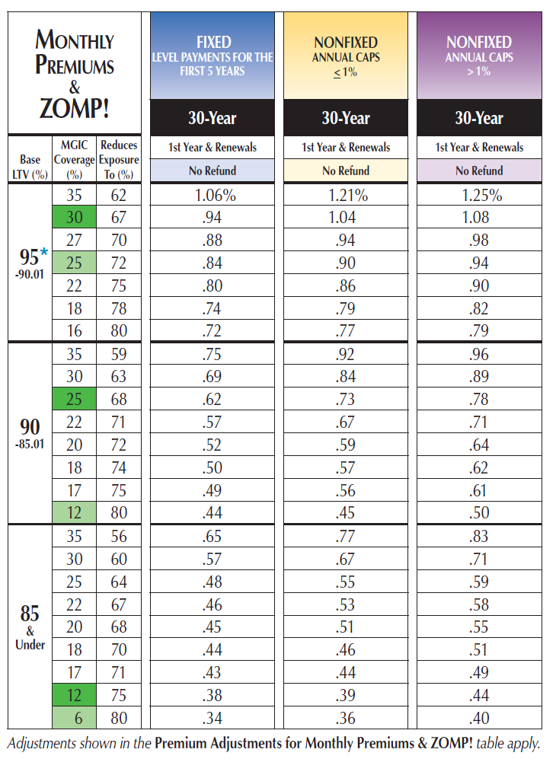

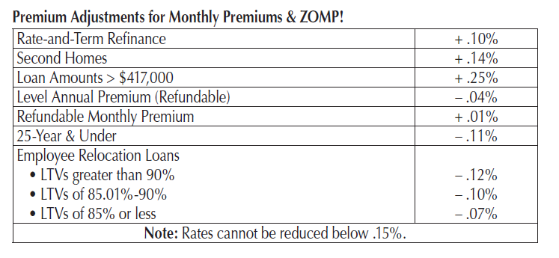
Updated MI Calculation
Example Loan:
Loan Seq Num: U60490000208
Step 1: Find the historical version of MIGC document before June 2009
firstPaymtDt | 4/1/2011
cs | 781
origLTV | 121
loanPurposeType | RE-FI-NCO
occType | OWNER
originalLoanAmount | 89,320
pctMtgIns | 20

Slide 5
Updated MI Calculation
Example Loan:
Loan Seq Num: U60490000208
Step 2: Look up the MI coverage
firstPaymtDt | 4/1/2011
cs | 781
origLTV | 121
loanPurposeType | RE-FI-NCO
occType | OWNER
originalLoanAmount | 89,320
pctMtgIns | 20
Problem:
There is not a unique LTV range: each of the possible LTV ranges has 20% coverage

Slide 6
Updated MI Calculation
Example Loan:
Loan Seq Num: U60490000208
Step 2: Look up the MI coverage
firstPaymtDt | 4/1/2011
cs | 781
origLTV | 121
loanPurposeType | RE-FI-NCO
occType | OWNER
originalLoanAmount | 89,320
pctMtgIns | 20
Problem:
There is not a unique LTV range: each of the possible LTV ranges has 20% coverage
Solution:
Check the LTV distribution of loans with MI coverage of 20%. Choose the LTV bucket that the majority of the loans fall in.

Slide 7
Suggested MI coverage Look up table MI coverage as a function of LTV distribution
LTV distribution
Criteria to combine the MI:
Pick all cells such that the cumulative distribution cover 80% or more of the balance. Then, calculate the weighted average MI premium by looking up the MI premiums corresponding to these cells.
MI Coverage | OLTV
 | < 80 | 85 | 90 | 95 | 97 | > 97
6 | 45% | 54% | 0% | 0% | 0% | 1%
12 | 0% | 34% | 51% | 0% | 1% | 14%
17 | 0% | 17% | 53% | 11% | 19% | 0%
18 | 0% | 1% | 17% | 83% | 0% | 0%
25 | 0% | 1% | 20% | 67% | 6% | 7%
30 | 0% | 0% | 10% | 72% | 16% | 3%
35 | 0% | 0% | 0% | 11% | 88% | 1%
40 | 0% | 0% | 0% | 1% | 7% | 92%
> 40 | 0% | 0% | 0% | 2% | 2% | 97%
MI Coverage From (>) | To (<=) | MI Premium
0 | 6 | 0.34
6 | 12 | 0.42
12 | 17 | 0.51
17 | 18 | 0.70
18 | 25 | 0.79
25 | 30 | 0.89
30 | 35 | 0.98
35 | 40 | 1.10
MI Premiums
MI Coverage | OLTV
 | < 80 | 85 | 90 | 95 | 97 | > 97
6 |  | 0.34
12 |  | 0.38 | 0.44
17 |  | 0.43 | 0.49 | 0.72
18 |  | 0.44 | 0.50 | 0.74 | 0.61
25 |  | 0.48 | 0.62 | 0.84 | 0.77
30 |  | 0.57 | 0.69 | 0.88 | 0.94
35 |  | 0.65 | 0.75 | 0.94 | 0.98
40 |  |  |  |  | 1.10
> 40

Slide 8
Updated MI Calculation
Example Loan:
Loan Seq Num: U60490000208
Step 2: Look up the MI coverage
firstPaymtDt | 4/1/2011
cs | 781
origLTV | 121
loanPurposeType | RE-FI-NCO
occType | OWNER
originalLoanAmount | 89,320
pctMtgIns | 20
Based on the historical MI documents, we assign 79 bps MI to the example loan instead of 110 bps.
Makes the incentive 31 bps lower.

Slide 9
Observations and Future Improvements
For non-HARPed loans where there is no ambiguity about which MI Rate Card applies, we make the simplification that the coverage level is constant within each LTV range. This is not quite true as even within a fixed LTV range there is some small variation in coverage levels. This would introduce modest differences in our MI premium calculations.
While the presentation is focused towards CQ/CR loans, in principle the method applies to any HARPed loan. The method is implemented on a broad level across all FNMA/FHLMC pools using the following assumptions:
CL loans: Identify whether it is HARPed or not using our HARP matching algorithms
CQ/CR loans: All HARPed
CK (Jumbo) loans: No HARP (we may want to revisit this at some point)
We are making the assumption that the MGIC rate card accurately represents the evolution of industry MI premiums. While this is the assumption we’re retaining for historical calculations, we may implement a scheme where current premiums are calculated as a simple average across 3-5 PMI providers.

